Slide 1
Membership Committee
Kara Bixby
Danelle Marable
Chantal Hoff
Trish Dao-Tran
Catherine Brooks
Daniel Parmer
Josh Lederman
Patrick Kinner
Programming Committee
Hila Bernstein
MJ Pattison
Sharon Touw
Dana Benjamin-Allen
Kelly Washburn
Governance
Trang Hickman (outgoing Treasurer)
Noe Medina (Clerk)
Patrick Kinner (Vice President)
Min Ma (President)
Sylvia Pu (Treasurer)
DEI Committee
Artie Maharaj
Alemayehu Bekele
Ben Faust
Christine Patton
Danelle Marable
Fatima Fairfax
Kathleen Sullivan
Katherine Aronson-Ensign
Luba Falk Feigenberg
Matan BenYishay
Noe Medina
Sarah Faude
Polly Hanson-Grodsky
Quyen Pham
Tiana Yom
Navjeet Singh
Communications
Stephanie Son (Intern)
Bryan Hall (outgoing chair)
GBEN runs on the shoulders of its volunteers.
Thank you for all you do!
Notes:
During gathering:
Min We thank outgoing Treasurer Trang Hickman & Communications chair Bryan Hall...and welcome new committee chairs to the Board!
Sylvia Pu, Treasurer
Daniel Parmer, Membership Co-chair
Patrick pastes in chat: Please type your name in the chat, affiliation, and a reflection: What was most memorable to you from your participation in GBEN in 2023?

Slide 2
2023 YEAR IN REVIEW

Slide 3
Plan for today
10:00 Gathering & Welcome
10:05 Celebrating 2023 - GBEN Annual Report
10:20 Reflection in community - breakout rooms
10:55 Closing
Notes:
Min
Excited to look back together on what we accomplished in 2023 and look ahead
20m in review
40m in conversation with each other (breakout rooms)
Goal of this meeting:
GBEN members - new and old - leave with a sense of connection to the org & have ideas of how they’d like to engage with GBEN this coming year

Slide 4
GBEN’s mission
Our mission is to promote excellence, innovation and equity in evaluation among professional and aspiring evaluators, and those who align their work with the discipline of evaluation in Greater Boston. We do this through professional development, resource-sharing, and networking around evaluation approaches and best practices.
Notes:
Patrick

Slide 5
Our strategic goal 2022-2025
Build a diverse and inclusive community of evaluation practitioners in Greater Boston that promotes excellence, innovation, and equity in evaluation.
Subgoal 1
Grow membership in diversity and size
Subgoal 2
Connect members to high-quality professional development that is responsive to trends in evaluation and members’ needs, and contributes to a more just and equitable field
Subgoal 3
Increase community-building with a focus on creating inclusion and belonging for new members, emerging evaluators, and folks of marginalized identities
Subgoal 4
Embed DEI principles into fabric of the organization
Notes:
Patrick
Patrick pastes link in chat: https://drive.google.com/file/d/1ZYfc0zhqKBEL7gNxPQF05ZerKk3cYCrY/view?usp=sharing

Slide 6
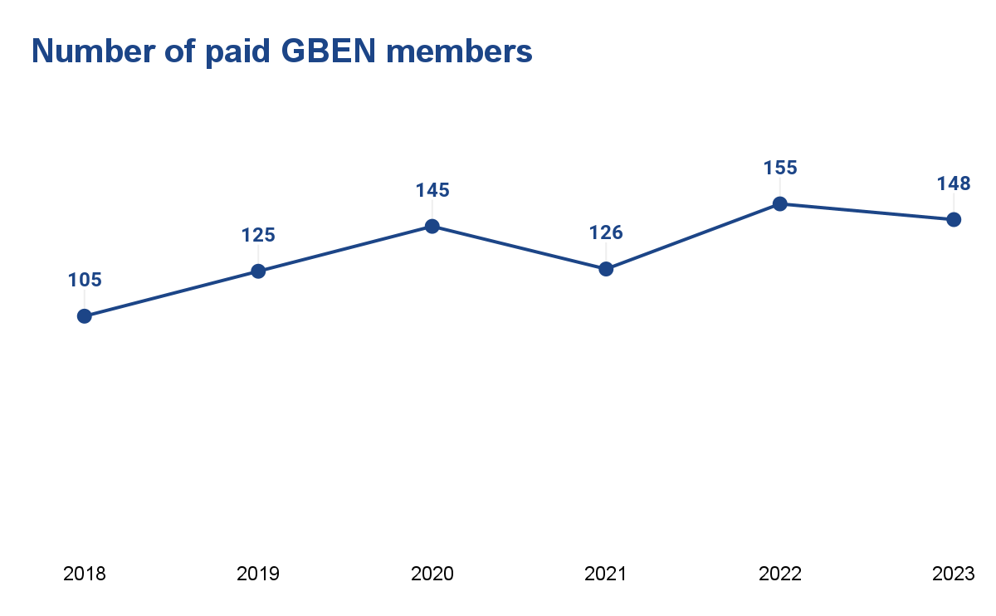
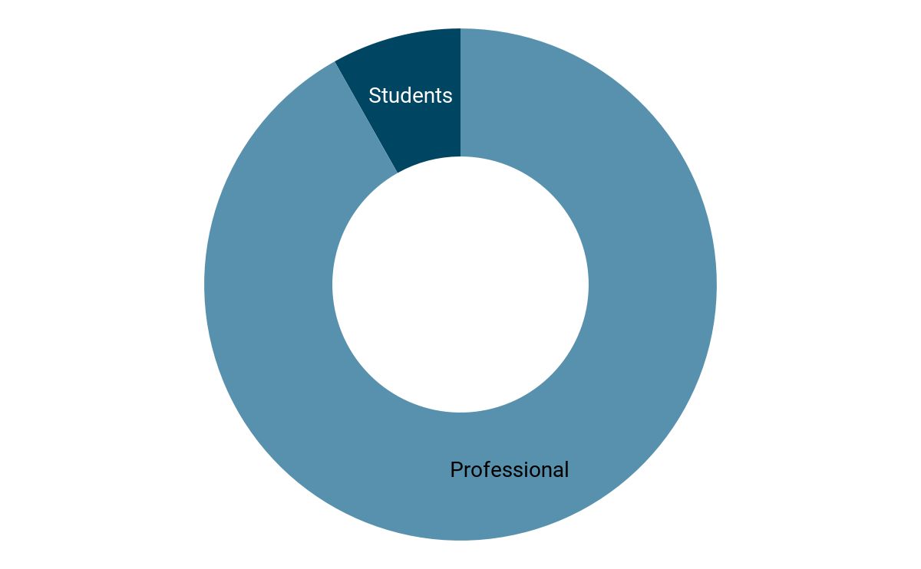
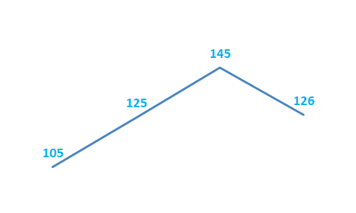
1 Grow membership in diversity and size
148 members
138 Professional Members (93%)
10 Student Members (7%)
2018 2019 2020 2021
Notes:
Chantal
From strategic plan: Here’s what we mean:
All learners and practitioners doing evaluation-related work welcome: Our strategies for growth will be inclusive of anyone who lives or works in the Greater Boston area and would like to contribute and grow professionally with GBEN.
Targeted strategies to diversify our membership: We will develop recruitment strategies and membership pathways that ensure a warm welcome and onboarding to the GBEN community for emerging evaluators, evaluators of color, and non-traditional evaluators (those who work in evaluation adjacent professions).
Emerging evaluators, evaluators of color, and professionals who do evaluation-related work will consider GBEN a professional home. They will be engaged members who step up as leaders, contribute to creating safe spaces for community building/discussion, and play a key role in shaping GBEN’s agenda.

Slide 7
2 High-quality professional development
Our Wonderful Presenters
9 Roundtables & workshops in 2023
64 members (48%) attended at least 1 event
Danelle Marable
Dana Benjamin-Allen
Katie Butler
Gretchen Biesecker
Julia Curbera
Carolyn (Carrie) Fisher
Laura McElherne
Amanda Robinson
Sharon Touw
Held our first multi-part series ever!
Topics by Content Type
Approach & Design
Deepening Participatory Practices
Eating & Liking Your Vegetables with OL-ECB AEA TIG
Community Learning
Data Viz Gallery Walk
Student Career Exploration in partnership with NU-PEL
Technical Skills
Using Space and Place in Evaluation
Adding Color to Your Data Collection Toolkit
3-part Other Duties as Assigned series
GBEN Partners
Organizational Learning and Evaluation Capacity Building (OL-ECB) TIG
Notes:
Kelly
Subgoal 2
Connect members to high-quality professional development that is responsive to trends in evaluation and members’ needs, and contributes to a more just and equitable field
Here’s what we mean:
Convening & connecting role: GBEN will play a convening/connecting role among members by hosting professional development events.
Fostering a culture of shared knowledge: Recognizing that learning and networking go hand in hand, we will foster a culture of shared knowledge among evaluators of different backgrounds and across career stages. We prioritize exchange of ideas over imparting expertise at our professional development events.
Content co-creation: We will co-create professional development ideas and events with members to ensure we’re being responsive to their needs. We will create and test different ways of soliciting ideas and feedback from members, and build these into existing events (eg, networking, orientation, roundtables)
Transparency and DEI lens to our programming decisions: We will be transparent about how we decide what types of events to put on and who we invite to speak/facilitate. We aim for equity and inclusivity in representation of speakers.

Slide 8
3 Community-building and belonging
gben@greaterbostoneval.org
Virtual connection:
Monthly newsletters delivered to paid GBEN members
Maintained LinkedIn group and Twitter account
http://greaterbostoneval.org
@EvalBoston
linkedin.com/groups/8177131/
Notes:
Chantal
Subgoal 3
Increase community-building with a focus on creating inclusion and belonging for new members, emerging evaluators, and folks of marginalized identities
Here’s what we mean:
Bringing our whole selves: We want GBEN to be a place where evaluators (present and emerging) and evaluation-adjacent folks can bring in all aspects of their professional and social identities
Professional and social support: We want GBEN members to have people to turn to for both professional networking and whole self support. GBEN members with professional connections or knowledge support those seeking these resources.

Slide 9
3 Community-building and belonging
Held another Member Orientation to create a warm welcome for and connect GBEN members with each other.
Connected with new members and reconnected with long-time members during four in-person social events: , including our AEA Happy Hour in Indianapolis, co-hosted with SCENE (October 2023).
Piloted Problems of Practice Office Hours during last year’s annual meeting, and then hosted four more PoP Office Hours during the year.
Notes:
Chantal

Slide 10
4 Embed DEI principles in fabric of the organization
Committee development
Recruited new DEI Chair, Committee structure & operating plans
Support across the organization
Refining DEI Questions for decision making
Conducting joint meetings with GBEN committees
Continuing Equitable Evaluation Discussion Group (open to GBEN members)
Supporting GBEN members with DEI questions and concerns
Notes:
Danelle
Subgoal 4
Embed DEI principles into fabric of the organization
Here’s what we mean:
Principles-focused approach: GBEN leadership develops, uses, and refines a set of DEI-informed principles for decision-making.
Reflective practice and improvement: GBEN leadership continually reviews, discusses, and improves our work to evaluate how it is advancing equity or perpetuating inequity.
Inclusive approach: GBEN leadership learns from and partners with GBEN members (in particular, members of color and new and emerging evaluators) to improve our practices, using the principle of invitation without burden.
Distributed leadership: GBEN leadership minimizes hierarchy within the GBEN Executive Committee, within other committees, and in GBEN community-building and programming efforts.

Slide 11
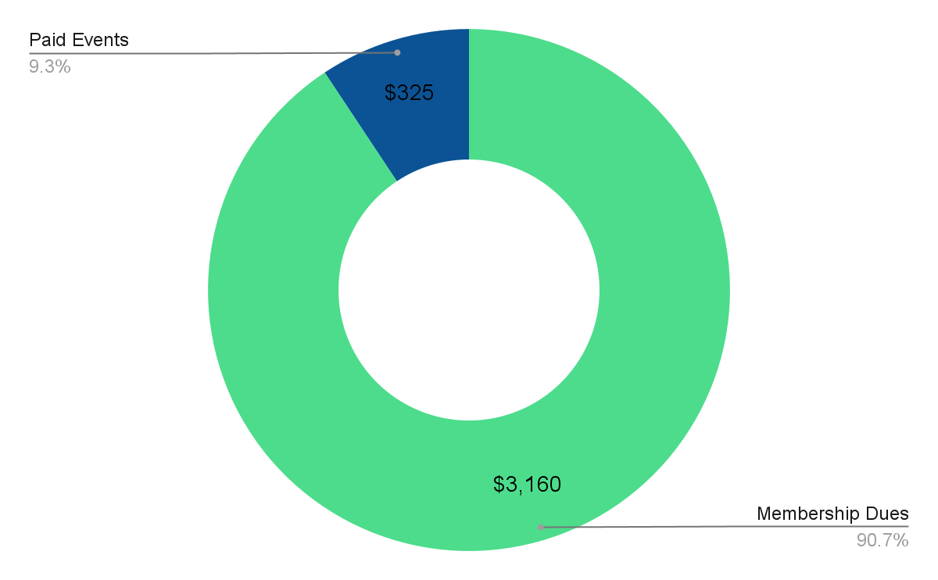
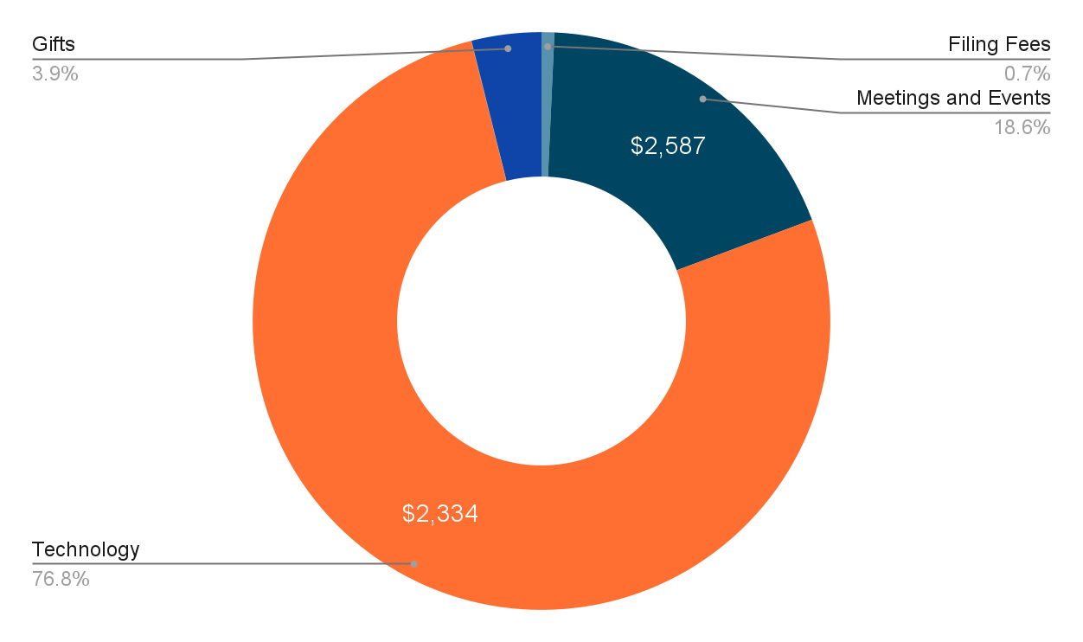
2023 income and expenses
Income $3,485
Expense breakdown
Notes:
Min
Income sources:
Primarily membership dues $3,160. This is down slightly from last year’s $3470 from membership
Paid events @$325
We do have a fee structure where non-members pay to participate in
Expenses
Most of our expenses are in technology: WA (website/membership mgt/newsletter) and Meetings/socials (honoraria, snacks)
We do give gifts to our outgoing leadership committee members
This year, we decided to transition Communications role to an intern supervised by Noe (Stephanie Son @ Northeastern); she’s the person behind our newsletter, event reminders, etc.

Slide 12
Break out rooms: Rose-Thorn-Bud
Rose-Thorn-Bud reflection on Miro board.
You’ll have ~25 minutes in your rooms to introduce yourself and discuss your professional rose-bud-thorn from 2023. Groups will facilitate themselves and will be asked to share out 1-2 takeaways.
Thinking back on your work in 2023…
Rose: Share a highlight, success, or something positive that happened.
Thorn: What has been challenging/difficult? What made it hard to be successful?
Bud: What most excites you about your work in 2024? What needs growth and nurturing?
Notes:
Chantal share screen, do quick Miro board demo
Add the names of who’s in your group to claim a board, and then start adding stickies to it!
Link to Miro board: https://miro.com/app/board/uXjVN2Udbg4=/?share_link_id=199432578836

Slide 13
Get involved! or Share an ask
Email us at: gben@greaterbostoneval.org or contact committee chairs directly
Governance: Min Ma & Patrick Kinner DEI Committee: Danelle Marable (interim co-chair); Sarah Faude Membership: Chantal Hoff, Daniel Parmer, Trish Dao-Tran Programming: Dana Benjamin-Allen & Kelly Washburn
Current openings:
DEI co-chair
Committee members (esp Programming)
Notes:
Current Openings:
DEI Co-Chair
Committee members - esp Programming

Slide 14
Thank You!!
gben@greaterbostoneval.org
http://greaterbostoneval.org
@EvalBoston
linkedin.com/groups/8177131/

